Slide 1
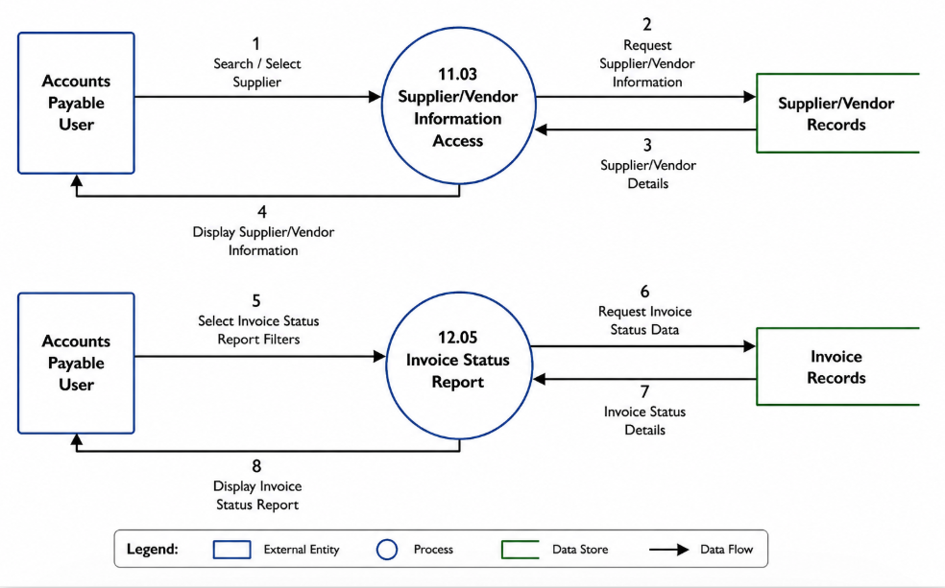
DFD – 11.03 Supplier/Vendor Information Access & 12.05 Invoice Status Report

